Slide 1
Chapter 3 - Data Modeling Using the Entity– Relationship (ER) Model

Slide 2
- Using High-Level Conceptual Data Models for Database Design - A Sample Database Application - Entity Types, Entity Sets, Attributes and Keys - Relationship Types, Relationship Sets, Roles, and Structural Constraints - Weak Entity Types - Refining the ER Design for the COMPANY Database - ER Diagrams, Naming Conventions, and Design Issues -Relationship Types of Degree Higher than Two
Content

Slide 3
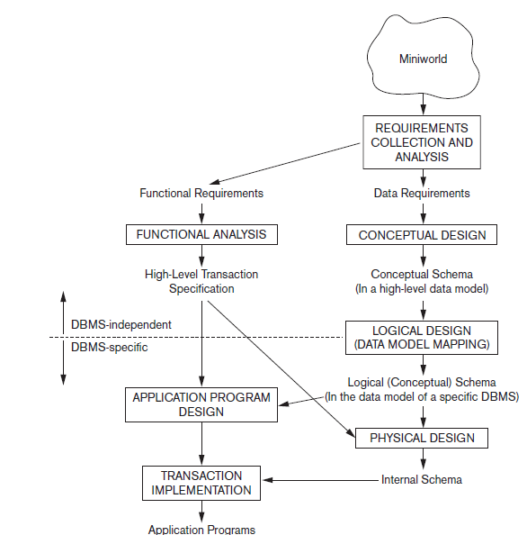
Using High-Level Conceptual Data Models for Database Design
Overview of the database design process.
STEP 1: Requirements collection and analysis.
The DB designers interview DB users to understand and document their data requirements.
The result of this step is a concisely written set of users’ requirements.
a description of the data used;
the details of how data is to be used;
any additional requirements for the new database system(security etc.).

Slide 4
Using High-Level Conceptual Data Models for Database Design
with listing the data requirements, it is useful to specify the known functional requirements of the application.
Functional requirements: User defined operations applied to the database, including both retrievals and updates.
For functional requirements specifications, data flow diagrams, sequence diagrams, scenarios, and other techniques are used.

Slide 5
Using High-Level Conceptual Data Models for Database Design
STEP 2: conceptual design
create a conceptual schema for the database, using a high-level conceptual data model.
conceptual schema:
concise description of the user data requirements
And detailed descriptions of the entity types, relationships, and constraints.
No implementation details included
easier to understand
Useful to communicate with nontechnical users.

Slide 6
Using High-Level Conceptual Data Models for Database Design
Conceptual database design is entirely independent of implementation details such as
the target DBMS software,
application programs,
programming languages,
hardware platform, or any other physical considerations.
Advantage: a good database design
AS database designers can focus on specifying the properties of the data, without thinking about storage and implementation details.

Slide 7
Using High-Level Conceptual Data Models for Database Design
STEP 3: logical design/data model mapping
the actual implementation of the database, using a commercial DBMS.
Use of an implementation data model—such as the relational (SQL) model
the conceptual schema transformation:
high-level data model -> implementation data model.
Result: database schema in the implementation data model of the DBMS.

Slide 8
Using High-Level Conceptual Data Models for Database Design
A logical model is derived depending upon the underlying data model of the target DBMS.
In other words, we know that the DBMS is, for example, relational or object-oriented.
Here other aspects of the chosen DBMS like physical details, such as storage structures or indexes are ignored.

Slide 9
Using High-Level Conceptual Data Models for Database Design
STEP4: physical design phase
describe how we intend to physically implement the logical database design.
For the relational model, this involves:
creating a set of relational tables and the constraints on these tables derived from the information presented in the logical data model.
identifying the storage structures and access methods for the data to achieve an optimum performance for the database system.

Slide 10
Using High-Level Conceptual Data Models for Database Design
In parallel with these activities,
application programs are designed
and implemented as database transactions corresponding to the high-level transaction specifications.

Slide 11
A Sample Database Application
We describe a sample database application, called COMPANY, which serves to illustrate the basic ER model concepts and their use in schema design.
We list the data requirements for the database here, and then create its conceptual schema step-by-step as we introduce the modeling concepts of the ER model.
The COMPANY database keeps track of a company’s employees, departments, and projects.

Slide 12
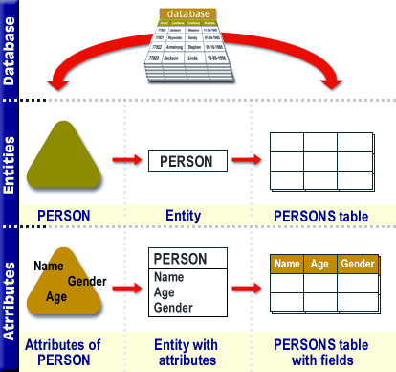
Entity Types, Entity Sets, Attributes, and Keys
Entities and Attributes
Entity: is a thing or object in the real world with an independent existence.
An entity may be an object with a physical existence (for example, a particular person, car, house, or employee)
or
it may be an object with a conceptual existence (for instance, a job, or a university course).
Attributes: properties that describe an entity.
For example, an EMPLOYEE entity may be described by the employee’s name, age, address, salary, and job.

Slide 13
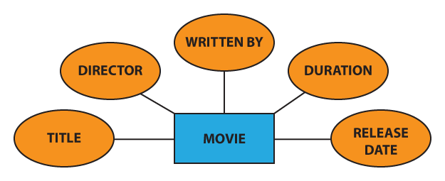
Entity Types, Entity Sets, Attributes, and Keys
Entities and Attributes
Representation in ER

Slide 14
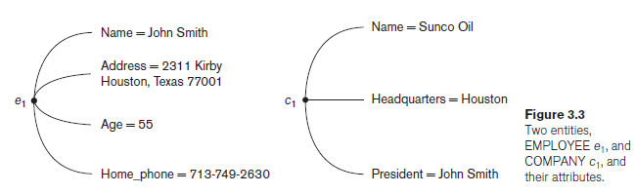
Entity Types, Entity Sets, Attributes, and Keys
Entities and Attributes
The EMPLOYEE entity e1 has four attributes: Name, Address, Age, and Home_phone; their values are ‘John Smith,’ ‘2311 Kirby, Houston, Texas 77001’, ‘55’, and ‘713-749-2630’, respectively.
The COMPANY entity c1 has three attributes: Name, Headquarters, and President; their values are ‘Sunco Oil’, ‘Houston’, and ‘John Smith’, respectively.
types of attributes: simple/composite, single valued/multivalued, and stored/derived.

Slide 15
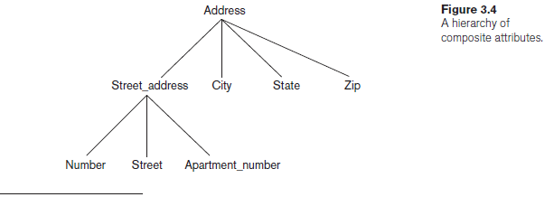
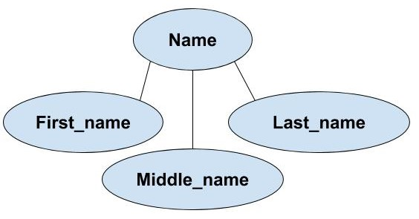
Entity Types, Entity Sets, Attributes, and Keys
Entities and Attributes
Composite versus Simple (Atomic) Attributes
Composite attributes
can be divided into smaller subparts, which represent more basic attributes with independent meanings.
Composite attributes can form a hierarchy:
for example, Street_address can be further subdivided into three simple component attributes: Number, Street, and Apartment_number, as shown in Figure 3.4.
The value of a composite attribute = concatenation of the values of its component simple attributes.

Slide 16
Entity Types, Entity Sets, Attributes, and Keys
Entities and Attributes
Composite versus Simple (Atomic) Attributes
For example, the Address attribute of the EMPLOYEE entity shown in Figure 3.3 can be subdivided into Street_address, City, State, and Zip,3 with the values ‘2311 Kirby’, ‘Houston’, ‘Texas’, and ‘77001’.
simple or atomic attributes: Attributes that are not divisible

Slide 17
Entity Types, Entity Sets, Attributes, and Keys
Entities and Attributes
Composite versus Simple (Atomic) Attributes
Where are Composite attributes used?
Useful to model situations in which a user sometimes refers to the composite attribute as a unit but at other times refers specifically to its components.
If the composite attribute is referenced only as a whole, there is no need to subdivide it into component attributes.
For example, if there is no need to refer to the individual components of an address (Zip Code, street, and so on), then the whole address can be designated as a simple attribute.

Slide 18
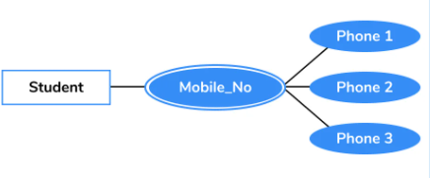
Entity Types, Entity Sets, Attributes, and Keys
Entities and Attributes
Single-Valued versus Multivalued Attributes.
Single-valued: Attributes have a single value for a particular entity.
For example, Age is a single-valued attribute of a person.
An attribute can have a set of values for the same entity
a Colors attribute for a car,
Cars with one color have a single value, whereas customized/sport cars might have two color values.
or a College_degrees attribute for a person.

Slide 19
Entity Types, Entity Sets, Attributes, and Keys
Entities and Attributes
Single-Valued versus Multivalued Attributes.
Multivalued:
Similarly, one person may not have any college degrees,
another person may have one,
and a third person may have two or more degrees;
therefore, different people can have different numbers of values for the College_degrees attribute.
Should contain lower and upper bounds to limit the no. of values allowed for each individual entity.
For example, the Colors attribute of a car may be restricted to have between one and two values, if we assume that a car can have two colors at most.

Slide 20
Entity Types, Entity Sets, Attributes, and Keys
Entities and Attributes
Stored versus Derived Attributes
In some cases, two (or more) attribute values are related
for example, the Age and Birth_date attributes of a person.
For a particular person entity, Age = the current date - the person’s Birth_date.
The Age attribute - derived attribute derivable by Birth_date
The Birth_date - stored attribute.
Some attribute values can be derived from related entities;
for example, an attribute Number_of_employees of a DEPARTMENT entity can be derived by counting the number of employees working for that department.

Slide 21
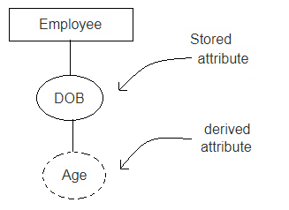
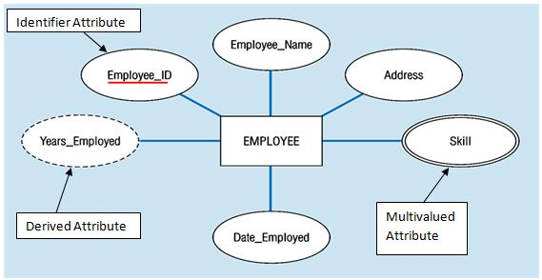
Entity Types, Entity Sets, Attributes, and Keys
Entities and Attributes
Stored versus Derived Attributes

Slide 22
Entity Types, Entity Sets, Attributes, and Keys
Entities and Attributes
NULL Values. (not APPLICABLE)
In some cases, a particular entity may not have an applicable value for an attribute.
For example: Apartment_number attribute of an address is valid for apartment buildings only and and not to other types of residences, such as single-family homes.
Similarly, a College_degrees attribute applies only to people with college degrees.
For such situations, a special value called NULL is created.
An address of a single-family home would have NULL for its Apartment_number attribute, and a person with no college degree would have NULL for College_degrees.
Don’t specify NOT NULL constraint over such attributes.

Slide 23
Entity Types, Entity Sets, Attributes, and Keys
Entities and Attributes
NULL Values. (UNKOWN)
NULL can also be used if we do not know the value of an attribute for a particular entity
for example, if we do not know the home phone number of ‘John Smith’ .
The unknown category of NULL can be further classified into two cases.
the attribute value exists but is missing
for instance, if the Height attribute of a person is listed as NULL.
Not known whether the attribute value exists or not
for example, if the Home_phone attribute of a person is NULL.

Slide 24

Entity Types, Entity Sets, Attributes, and Keys
Entities and Attributes
Complex Attributes
Composite and multivalued attributes can be nested.
Complex Attributes: We can represent nesting by:
grouping components of a composite attribute between parentheses ( )
and separating the components with commas,
and by displaying multivalued attributes between braces { }.
For example, if a person can have more than one residence and each residence can have a single address and multiple phones, an attribute Address_phone for a person can be specified as shown in Figure 3.5.4 Both Phone and Address are themselves composite attributes.

Slide 25
Entity Types, Entity Sets, Attributes, and Keys
Entity Types, Entity Sets, Keys, and Value Sets
Entity Types and Entity Sets
A database usually contains groups of entities that are similar.
For example, a company employing hundreds of employees may want to store similar information concerning each of the employees.
These employee entities share the same attributes, but each entity has its own value(s) for each attribute.
Entity type: Defines a collection (or set) of entities that have the same attributes. Each entity type in the database is described by its name and attributes.
Figure 3.6 shows two entity types: EMPLOYEE and COMPANY, and a list of some of the attributes for each. A few individual entities of each type are also illustrated, along with the values of their attributes.

